Slide 1

What Is Application Security?
#appsecurity #cybersecurity

Slide 2
Defining App Security
Application security is the process of
developing,
adding and
testing security features in applications
That can minimize weaknesses against possible threats from unauthorized access.
It should be considered at all phases if software development
Design
Development
Testing
Deployment
Maintenance

Slide 3
Web App Security
Web App – Software that’s accessible over internet
Data availability over internet so that its accessible - insecure
Attack surface increased
Cybercriminals target webapps to steal PII informations
Solutions to secure the web apps
There is not one one single way to secure, has to be be multiple layers

Slide 4
API Security
Apps communicate to each other in the backend to fulfil the request
Widely used in microservices architecture
More Integration more chance of attack
There is difference between web app and api attacks
Sources of attack
Frequently updated and deployed

Slide 5
Why Business need security
Money loss
Trust among users
Many types of attacks
Bot Attacks
Client side attacks

Slide 6
Next..
Top Security threats
AppSec Tools
Third party tools for app security
OWASP
Security consideration Generative AI

Slide 7
Bot Attacks Client-side Attacks
#appsecurity #cybersecurity

Slide 8
Bot Attacks
Web scrapping
Inventory hoarding
Carding
Account takeover
Credential stuffing

Slide 9
Client-side Attacks
Supply chain attacks
PII harvesting
Formjacking
Digital skimming
Magecart

Slide 10
Top 10 OWASP Security Threats
#appsecurity #cybersecurity

Slide 11
Top 10 OWASP Threats
OWASP – Open Web Application Security Project
Link - https://owasp.org/www-project-top-ten/
Broken Access Control
Cryptographic Failures
Injections
Insecure design
Security Misconfiguration
Vulnerable and outdated component
Identification and Authentication failure
Software and data integrity issues
Security logging and monitoring failures
Server Side Request Forgery

Slide 12
Impact & Prevention Top 10 OWASP Security Threats
#appsecurity #cybersecurity

Slide 13
1. Broken Access Control
Impact
Unauthorized users can access and modify sensitive data, perform unauthorized actions, and exploit system functionalities.
Prevention
Implement role-based access control (RBAC).
Enforce least privilege principle.
Regularly review and update permissions.
Use access control frameworks and libraries.

Slide 14
2. Cryptographic Failures
Impact
Exposure of sensitive data such as passwords, credit card numbers, and personal information.
Fines and charges by authorities due non compliance of privacy
Prevention
Use strong, industry-standard encryption algorithms.
Properly manage and protect cryptographic keys.
Implement HTTPS and secure communication channels.
Regularly audit and update cryptographic protocols.

Slide 15
3. Injection
Impact
Attackers can execute arbitrary commands, steal data, and escalate privileges
Loss of user integrity
Response manipulation
Prevention
Use parameterized queries and prepared statements.
Validate and sanitize all user inputs.
Use ORM frameworks that handle query construction securely.
Implement input validation and output encoding.

Slide 16
4. Insecure Design
Impact
Fundamental security flaws in the design can lead to severe vulnerabilities that are hard to mitigate after deployment.
Altering functionality
Prevention
Adopt secure design principles from the outset.
Perform threat modeling during the design phase.
Regularly review and update the design to address new threats.
Educate developers on secure design practices.

Slide 17
5. Security Misconfiguration
Impact
Systems and data can be exposed due to insecure default settings, incomplete configurations, or open cloud storage.
Complete access over the server
Prevention
Implement automated configuration management tools.
Regularly review and update configurations.
Use secure defaults and minimize administrative access.
Conduct regular security audits and penetration tests.

Slide 18
6. Vulnerable and Outdated Components
Impact
Exploitation of known vulnerabilities in outdated software components can lead to data breaches and system compromises.
Prevention
Regularly update and patch software components.
Use dependency management tools to track and update libraries.
Subscribe to security advisories and vulnerability databases.
Implement a policy for software updates and patch management.

Slide 19
7. Identification and Authentication Failures
Impact
Attackers can gain unauthorized access to systems by exploiting weak authentication mechanisms.
Prevention
Implement multi-factor authentication (MFA).
Use strong, hashed passwords and enforce password policies.
Securely manage session tokens and invalidate them after logout.
Regularly test authentication mechanisms for vulnerabilities.

Slide 20
8. Software and Data Integrity Failures
Impact
Compromise of software integrity can lead to backdoors, malicious updates, and data corruption.
Prevention
Implement code signing and verify integrity of software updates.
Use secure update mechanisms and trusted distribution channels.
Perform regular integrity checks on critical data and software.
Employ version control and change management practices.

Slide 21
9. Security Logging and Monitoring Failures
Impact
Lack of proper logging and monitoring can allow attackers to go undetected, leading to prolonged breaches.
Prevention
Implement comprehensive logging and monitoring solutions.
Ensure logs are tamper-proof and securely stored.
Regularly review logs and set up alerts for suspicious activities.
Conduct regular security audits and incident response drills.

Slide 22
10. Server-Side Request Forgery (SSRF
Impact
Attackers can manipulate server-side requests to access internal systems and sensitive data.
Prevention
Validate and sanitize all user inputs that generate server-side requests.
Restrict the use of network protocols and internal IP address ranges.
Implement network segmentation to limit the impact of SSRF.
Use firewalls and access control lists to restrict outbound requests.

Slide 23
What is BOT? Good Bot Bad Bot
#appsecurity #cybersecurity

Slide 24
What is a Bot?
Web robot
Software application programmed to execute automated tasks over internet
More than half of internet traffic can be attributed to bots
Examples
Search engine web crawlers
Chat bot for customer service
Virtual assistants

Slide 25
How do Bots Work?
Scanning content
Chatting with users
Web pages interaction

Slide 26
Good vs Bad Bot
Good
Web crawlers
Chat bots
Bad
Malicious tasks
Executed from competitors

Slide 27
Most common bot attacks
Account take over
Carding
Web scrapping

Slide 28
Detecting Bad Bots
Increased login failures
Spike in account creation
Gift card validation failures
Increased shopping cart abandonment

Slide 29
Getting rid of Bad Bots
The solution opted should be
Fast
Accurate
Friction Free
Mobile Ready
Low Risk

Slide 30
What is CAPTCHA?
#appsecurity #cybersecurity

Slide 31
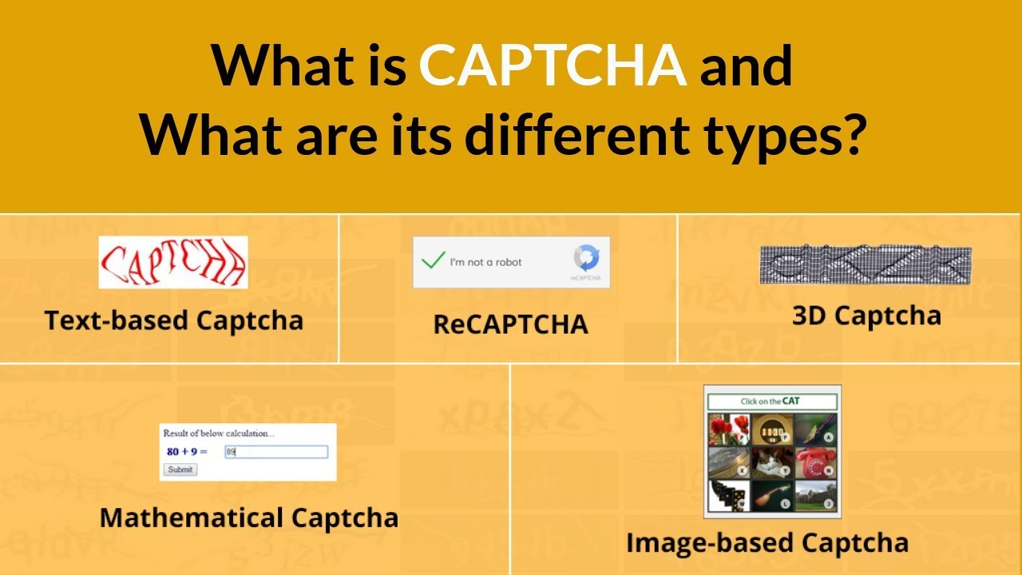
What is CAPTCHA?
Completely Automated Public Turing test to tell Computers and Humans Apart
Challenge response test
Types
Text
Image
Math
Audio

Slide 32
How do they work?
Presents Challenges that only Human can solve
Based on response app owner can take decision to block the bot

Slide 33
Why are they used?
To detect malicious bots

Slide 34
Challenges with CAPTCHA
Ineffective against sophisticated
Lower conversion rate
Negative user experience
Don’t support all browser
False positives
Inaccessible

Slide 35
Better options
User-friendly
Accurate
Behind-the-scenes detections
Scenario-optimized
Accessibility

Slide 36

Introduction & Getting Started
Privacy & Code security concern
Code explanation
Code Suggestion
Test Cases
Part-1
Part-2
PR Assist

Slide 37


CVE-2024-37051 JetBrains IDEs at risk of GitHub access token compromise
Security Alert
#vulnerability #cve #appsecurity #cybersecurity #codefarm

Slide 38
What is it?
It's a critical vulnerability (CVE-2024-37051) in JetBrains IDEs that could compromise GitHub access tokens.
Github plugin

Slide 39
Should I be concerned about it?
Yes, if you use JetBrains IDEs with the GitHub plugin, your GitHub repositories could be at risk of unauthorized access and manipulation.

Slide 40
What measures to mitigate the risk?
Update your JetBrains IDEs, revoke existing GitHub access tokens, and reset the GitHub plugin configuration.

Slide 41
Reference
https://www.cve.org/
CVE (Common Vulnerabilities and Exposures) is a system that identifies and names publicly known security vulnerabilities.
https://www.cve.org/CVERecord?id=CVE-2024-37051
https://blog.jetbrains.com/security/2024/06/updates-for-security-issue-affecting-intellij-based-ides-2023-1-and-github-plugin/

Slide 42
Template

Slide 43
Template

